Slide 1
Coffee Shop Analysis
Data Visualization using Tableau

Slide 2
INDEX
Objective
Executive Summary and key findings
Exploratory Analysis
Conclusion/Recommendation

Slide 3
Objective
The owner of Coffee Shop wants to use their past sale and profit data of different types of product/category they sell across 20 states and come up with answer to following questions.
Did you preprocess the data? Why or why not?
What visual mappings / representations did you choose? Why those?
Are there any patterns/trends in the data that your visualization highlights?
Is your visualization useful? If yes, how so? If no, why not?
Was anything harder than you expected? Easier?

Slide 4
Executive Summary and key findings
Coffee Shop Analysis

Slide 5
Executive Summary and key findings
Two years sample Data: Analysis is performed on sales data of 12 days in January for year 2010 and 2011.
Significant increasing profit trend- analyzing 2010 to 2011 sales and profit data – there is no significant increase(~ avg. 4%) in sales number but there is on avg. 45% increase in profit for Jan 2011.(Slide 9-10)
> Regular Tea category shows highest profit in Jan 2011 i.e. knowing no significant increase in sales we can say Price increase has worked in favor for café evident in Jan 2011. (Slide 10)
> Overall Coffee category dominates profit share ~27%+ of total profit and Columbian coffee being the highest profit generating ~17%+ product type cumulative 2010 and 2011. (Slide 11-12)

Slide 6
Executive Summary and key findings
Sales as well profits are clearly dominated by regular caffeination with SalesShare: 58% ProfitShare: 60% (Slide 13,14)
Profit vs. Sales scatter plot clearly shows profit boost in 2011 with almost same sales as in 2010. (Slide 15)
West region is the most profit and sales generating region and Tea Category dominates in west. (Slide 16-17)
> State-wise: California is most sales and profit generating state. Alone it holds SalesShare:12% and ProfitShare: 14% of total across globe.

Slide 7
Exploratory Analysis
Coffee Shop Analysis

Slide 8
Exploratory Analysis and Data Preperation
Data is provided is of some Coffee shop 12 days sales and profit data for Jan year 2010 and 2011.
Data looks very much in shape and no need to any missing value or outlier treatment
Need to fix State names 2 char codes to Full names for supplied 20 states of US.
Key features in data set are sales, profit, region, state, category, type and caffeination
Following slides are screenshots taken from Tableau.

Slide 9
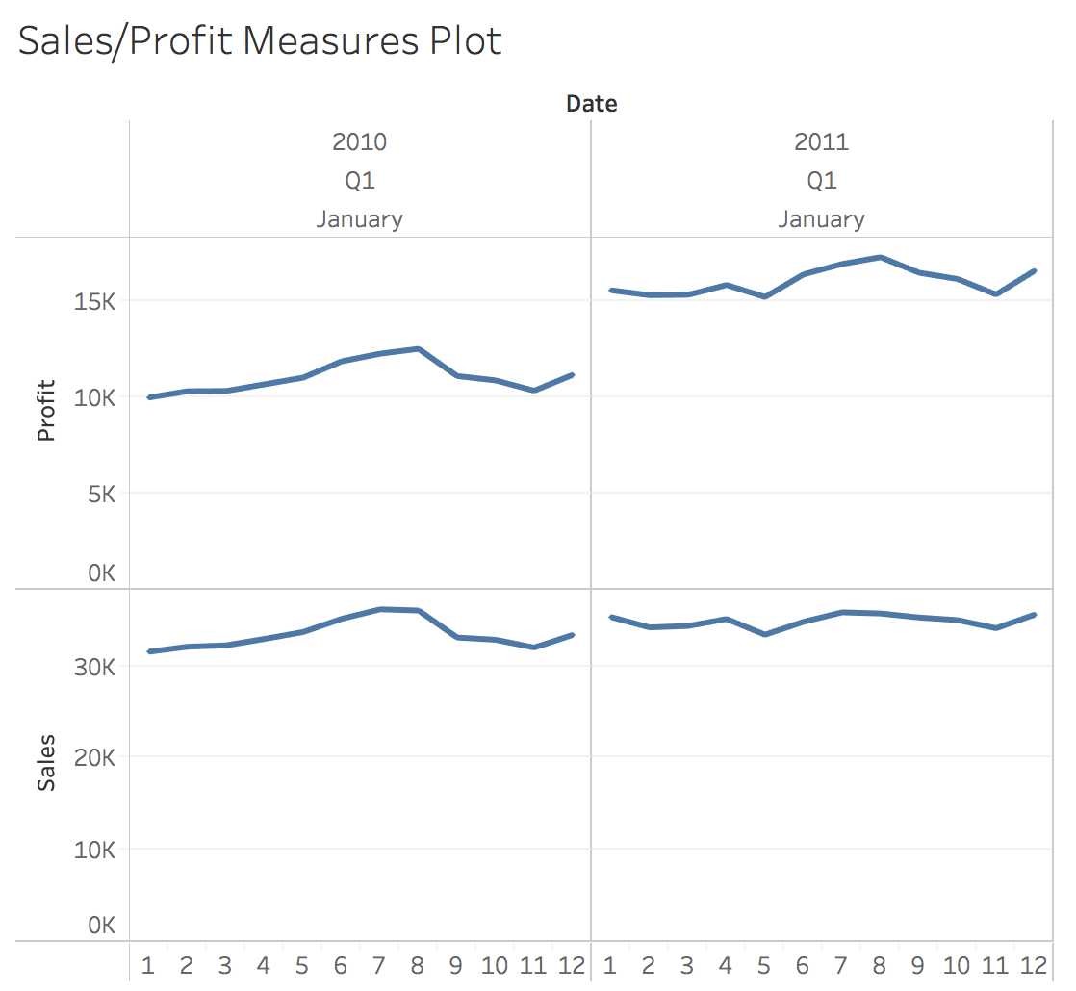
Sales and profit for days in Jan 2010 Vs. Jan 2011
~45% avg. Increase in Profit
Just ~4% avg. increase in Sales
Years total : Sales: 819811 Profit ($): 325527

Slide 10
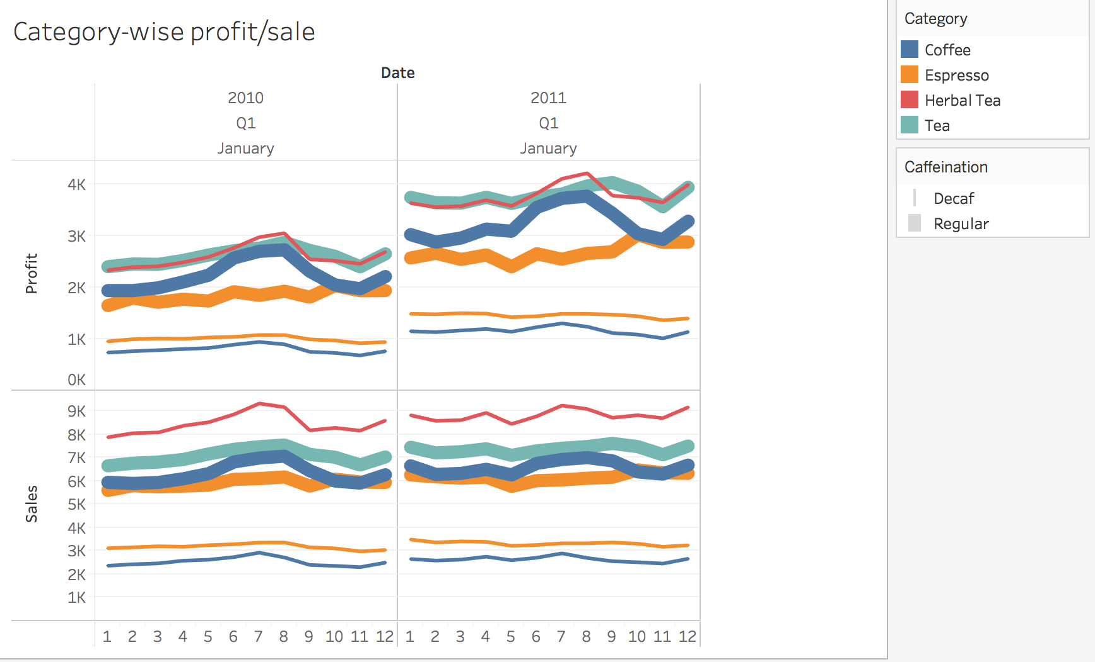
Sales and profit across various category and Caffeination
Regular Tea category has shown +ve Price change effect
Sales has remained almost same with 4% avg. increase
Avg. % increase total : Sales: 4% Profit: 45%

Slide 11
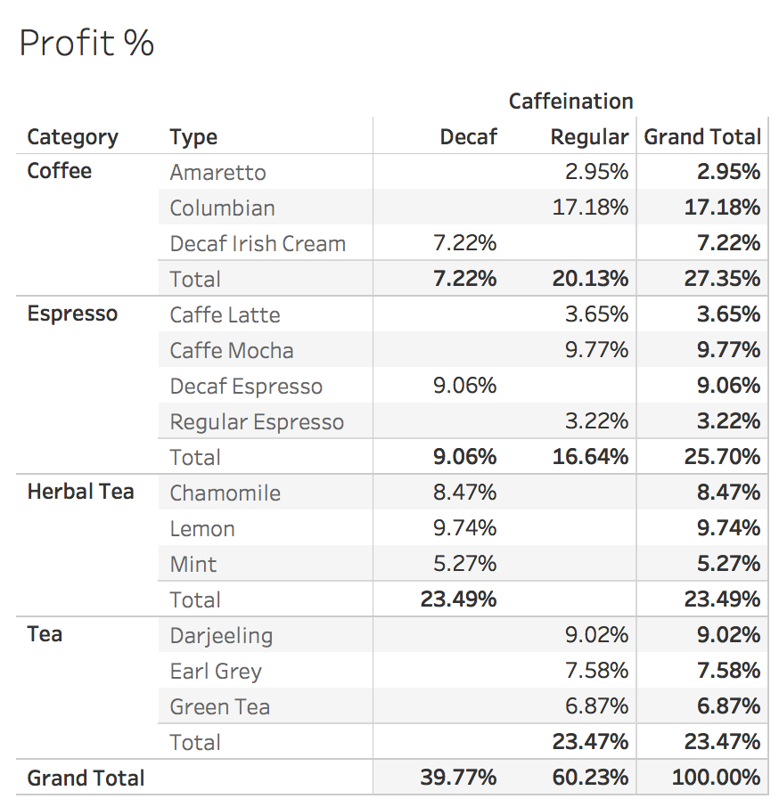
%Profit share Category, Type and Caffeination wise

Slide 12
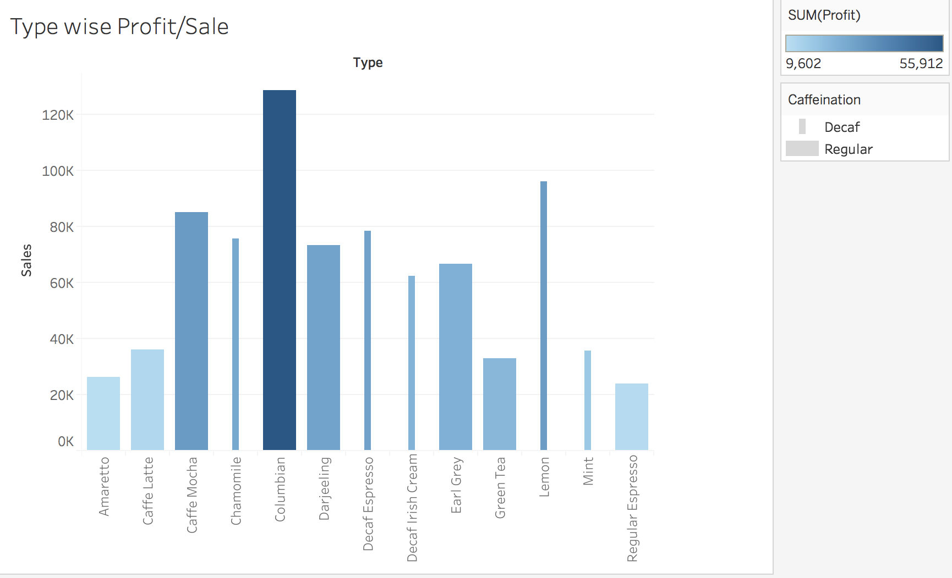
Product type wise Profit(Color)/Sale(Bars)/Caffeination(Bar-Size)
Avg. Daily total : Service Calls: 4.76 Scheduled Calls: 4.74 Dispatched Calls: 4.75 Revenue($): 2,124

Slide 13
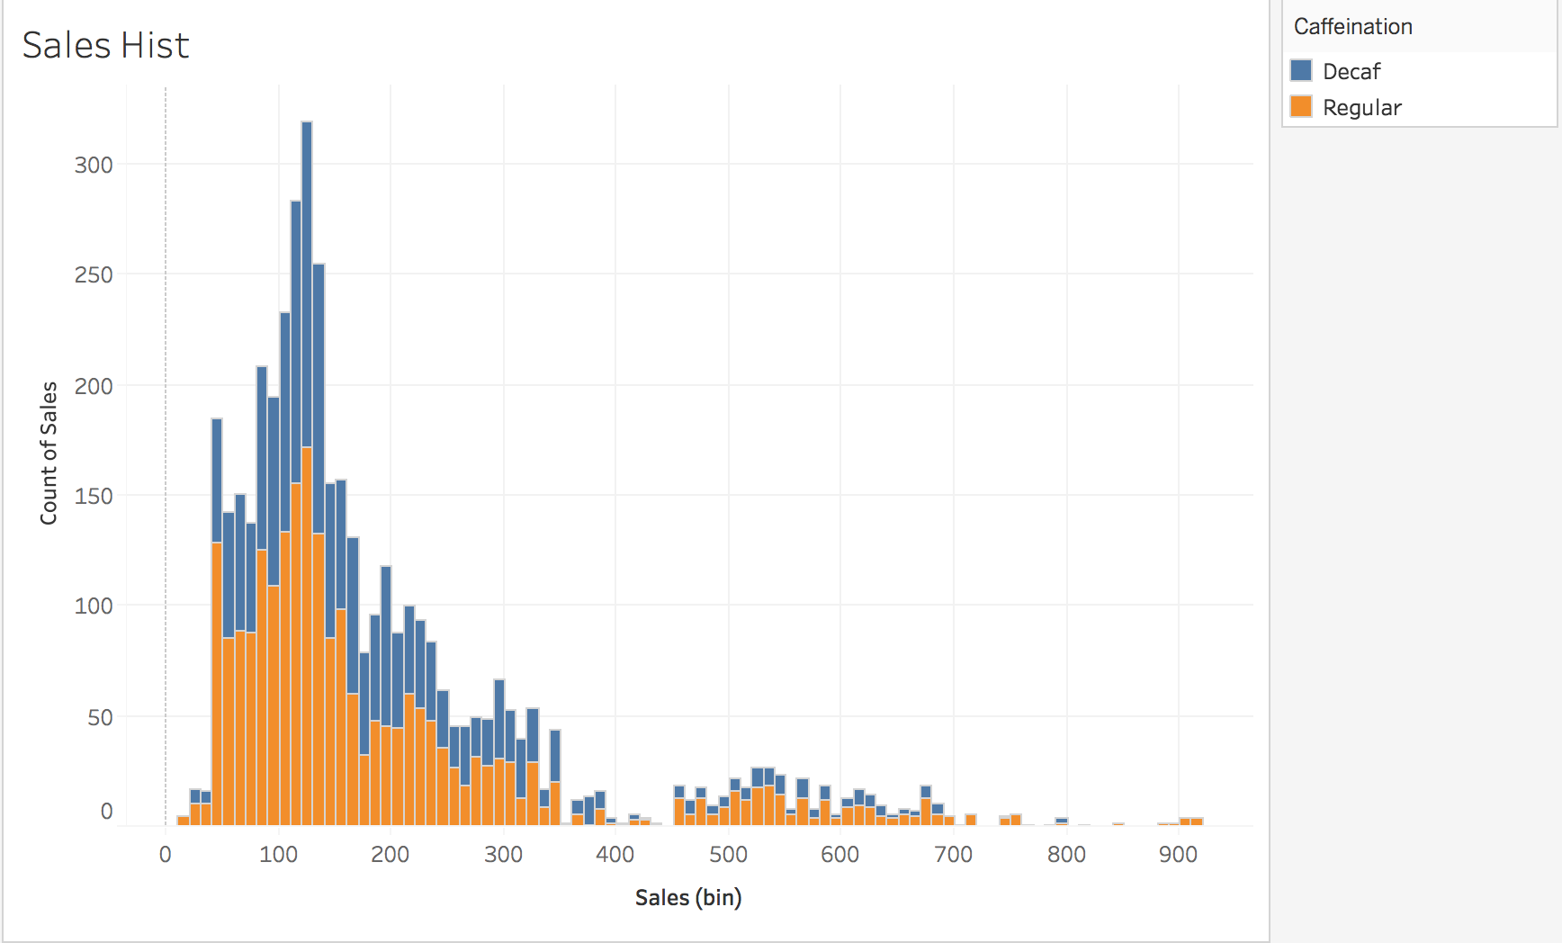
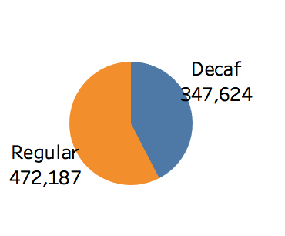
Sales Distribution with Caffeination highlighted(color)
Regular Caffeinating type dominates sales (58% share)
Avg. Daily total : Service Calls: 4.76 Scheduled Calls: 4.74 Dispatched Calls: 4.75 Revenue($): 2,124

Slide 14
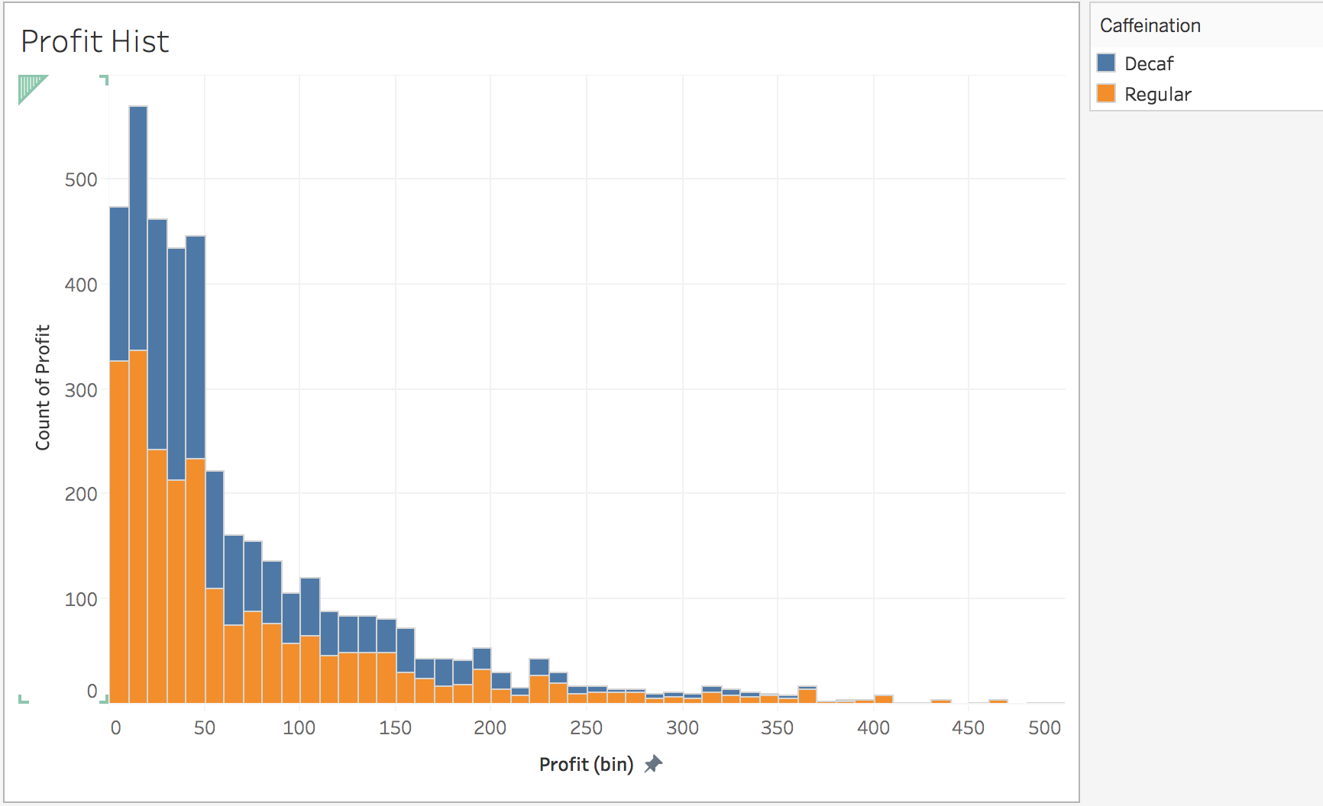
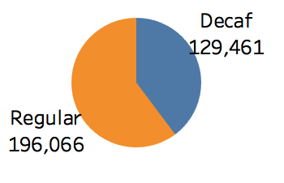
Profit distribution with Caffeination highlighted(color)
Regular Caffeinating type dominates profit (60% share)
Avg. Daily total : Service Calls: 4.76 Scheduled Calls: 4.74 Dispatched Calls: 4.75 Revenue($): 2,124

Slide 15
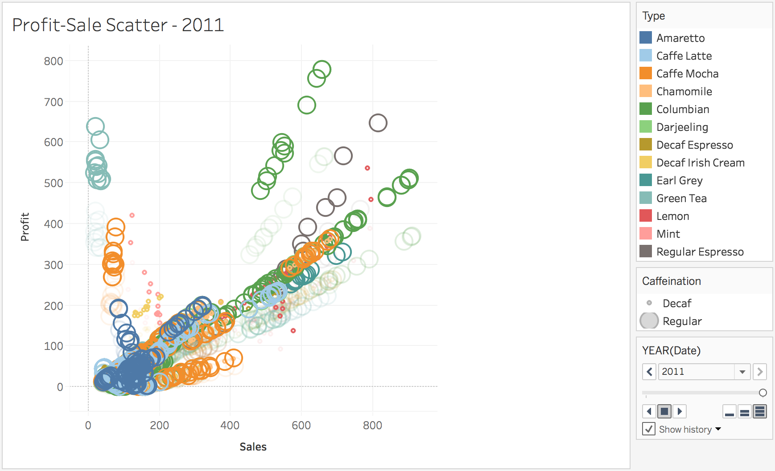
Sales vs. profit Scatter plot with Type(Clr), caffeination(Size) and Year(Fade)
Avg. Daily total : Service Calls: 4.76 Scheduled Calls: 4.74 Dispatched Calls: 4.75 Revenue($): 2,124

Slide 16
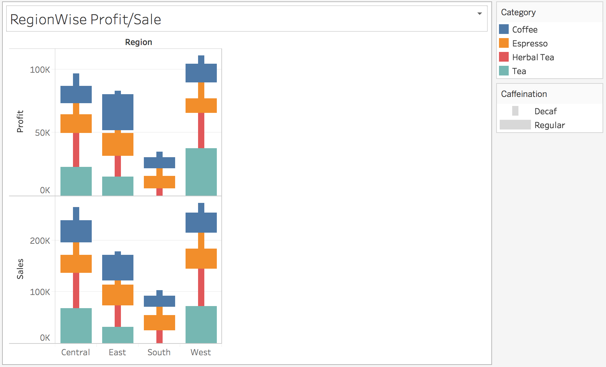
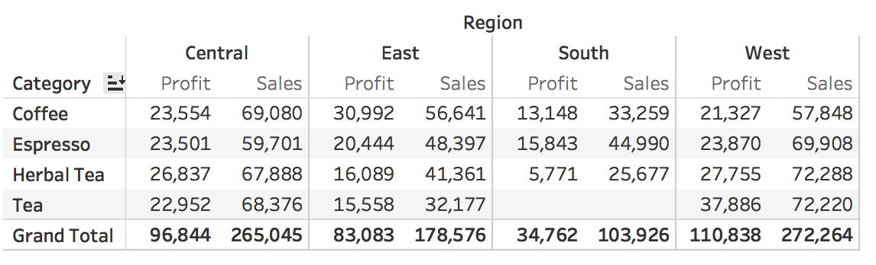
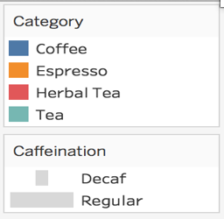
Region wise Profit/Sale- Category (Color), Caffeination(Size)
Avg. Daily total : Service Calls: 4.76 Scheduled Calls: 4.74 Dispatched Calls: 4.75 Revenue($): 2,124

Slide 17
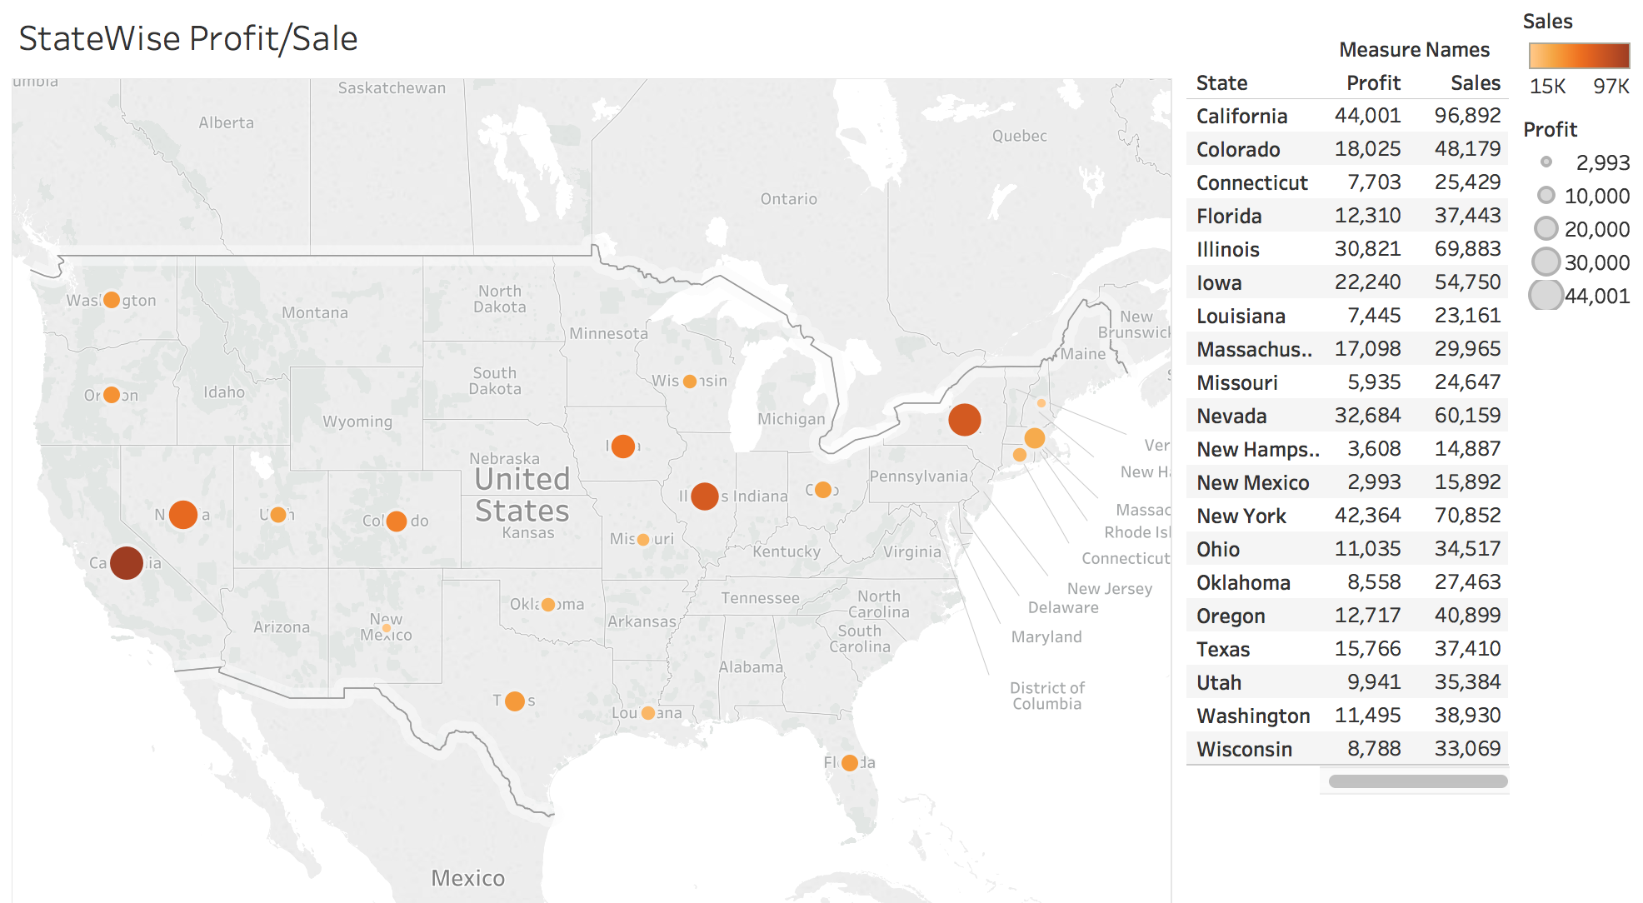
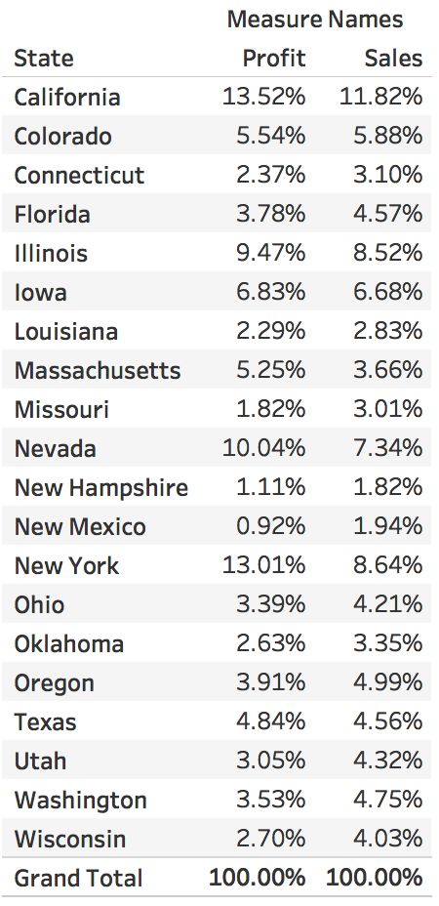
Product type wise Profit(Color)/Sale(Bars)/Caffeination(Size)
Avg. Daily total : Service Calls: 4.76 Scheduled Calls: 4.74 Dispatched Calls: 4.75 Revenue($): 2,124

Slide 18
Conclusion/Recommendation
Only 4% increase in sales over a year which is alarming.
Price change from 2010 to 2011 worked in favor for Café in almost all categories of products. Though sales increase is just 4% profit increase is 45% in 2011 over 2010.
Café needs to review their business strategy in south region sales and profit is least there.
> Tea category has almost nil sales in South
> Café need to promote Tea in south with top line products.

Slide 19
Thank You

